Slide 1


Angular Query
+

Slide 2

Notes:
Add SB and Angular Logo
Add link to the repo

Slide 3



Alfredo
Perez
bit.ly/ng-query-peru

Slide 4

Alfredo
Perez
@alfrodo_perez
bit.ly/ng-query-peru

Slide 5
TIPOS DE ESTADOS EN UI

Slide 6


Slide 7
Estado de Componente
Estado
Global
Estado por Funcionalidad

Slide 8
Estado del Servidor

Slide 9
Beneficios
UI Optimista
Mejor
UX
Estado
Sincronizado

Slide 10
Beneficios
UI Optimista
Estado
Sincronizado
Mejor UX
Cargas Eficientes
Facilidad Testeo
Estado Desacoplado
Notes:
Podemos crear UI Optimista ddebido a que Podemos reflejar cambiios sin tener ques esperar respuesta del servidor, y esto no da una mejor ux. Tambien logramos tener estado sincronizado en todos nuestros components ya que estamos la misma Fuente y como consecuencia nos da unas cargas mas eficientes. Por ultimo es mas facil de testeaar ya que el estado estara desacoplado de los components.

Slide 11
ANGULAR QUERY

Slide 12
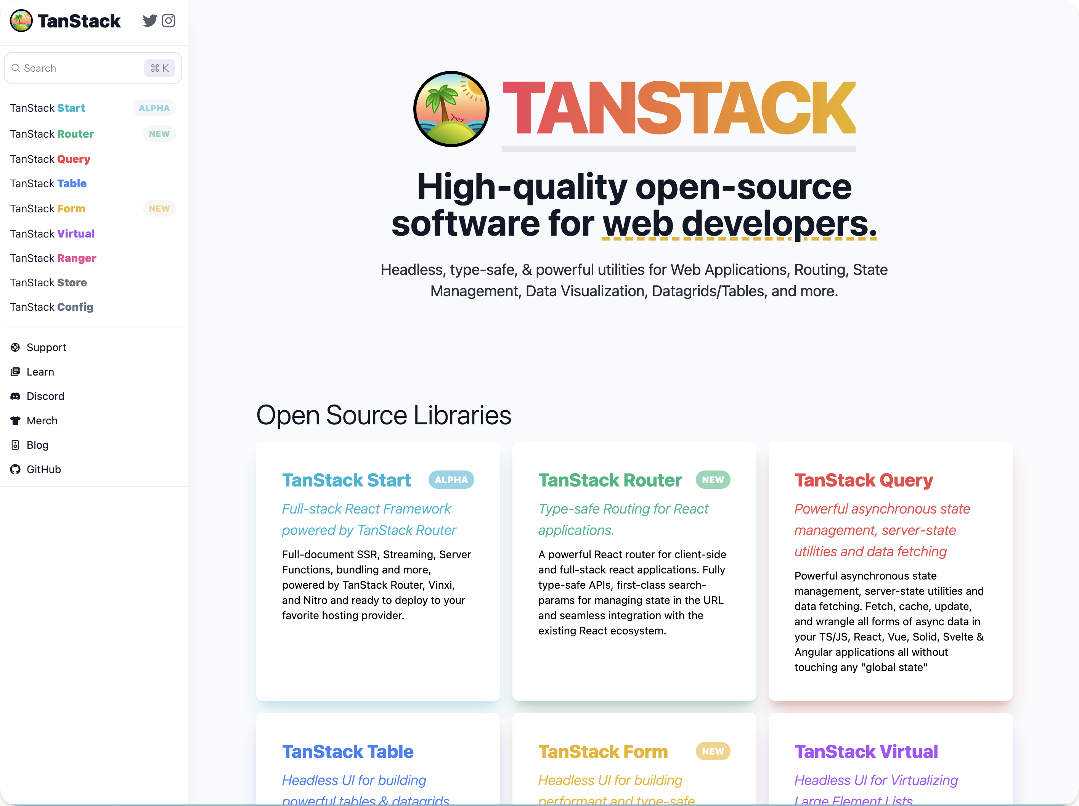

Slide 13
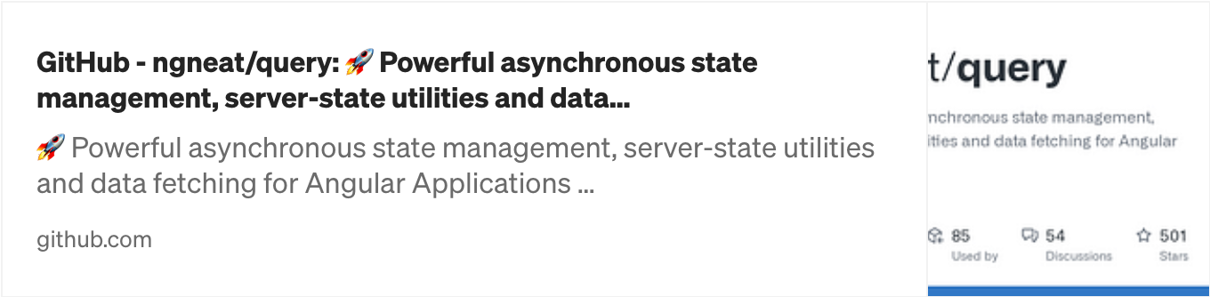
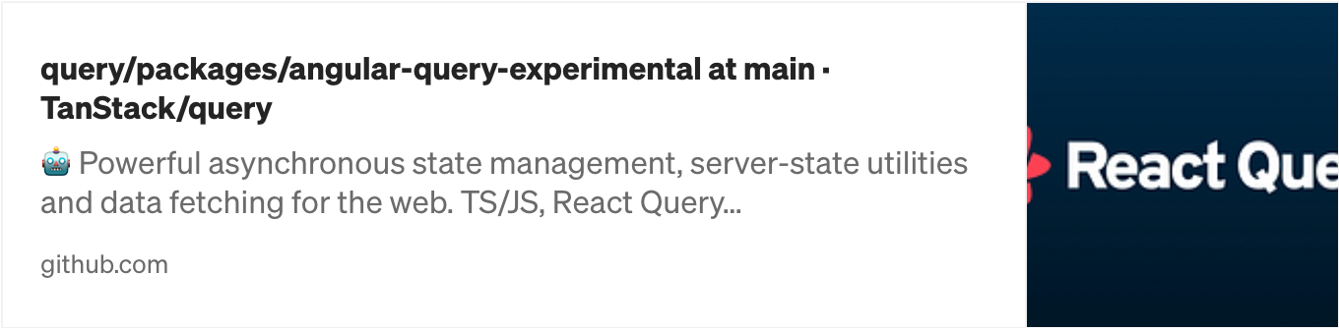

Slide 14
INSTALACION

Slide 15
export const appConfig: ApplicationConfig = {
providers: [
provideRouter(appRoutes),
provideHttpClient(),
provideAnimations(),
],
};

Slide 16
import {
provideAngularQuery,
QueryClient,
} from '@tanstack/angular-query-experimental’;
export const appConfig: ApplicationConfig = {
providers: [
provideRouter(appRoutes),
provideHttpClient(),
provideAnimations(),
// 👇 Provide the Query Client
provideAngularQuery(new QueryClient()),
],
};

Slide 17
@Component({
standalone: true,
imports: [],
selector: 'starter-root’,
template: `
<div class="layout-container">
</div>
`,
})
export class AppComponent {}

Slide 18
@Component({
standalone: true,
imports: [
// 👇 Import the Dev Tools
AngularQueryDevtools
],
selector: 'starter-root’,
template: `
<div class="layout-container">
<!-- 👇 Add the component -->
<angular-query-devtools initialIsOpen/>
</div>
`,
})
export class AppComponent {}

Slide 19
USANDOLO

Slide 20
export class UsersPageComponent {
#usersApi = inject(UsersApiService);
currentPage = signal(1);
usersRequestOptions = computed(() => {
return {
pagination: {
limit: 20,
page: this.currentPage(),
},
orderBy: 'createdAt’,
} as RequestOptions;
});
onPageChange(e: PaginatorState) {
this.currentPage.update( () => (e.page ? e.page + 1 : 1));
}

Slide 21
export class UsersPageComponent {
#usersApi = inject(UsersApiService);
currentPage = signal(1);
usersRequestOptions = computed(() => {
return {
pagination: {
limit: 20,
page: this.currentPage(),
},
orderBy: 'createdAt’,
} as RequestOptions;
});
usersQuery = injectQuery(() => ({
queryKey: ['users', this.usersRequestOptions()],
}));
onPageChange(e: PaginatorState) {
this.currentPage.update( () => (e.page ? e.page + 1 : 1));
}

Slide 22
export class UsersPageComponent {
#usersApi = inject(UsersApiService);
currentPage = signal(1);
usersRequestOptions = computed(() => {
return {
pagination: {
limit: 20,
page: this.currentPage(),
},
orderBy: 'createdAt’,
} as RequestOptions;
});
usersQuery = injectQuery(() => ({
queryKey: ['users', this.usersRequestOptions()],
queryFn: () =>
this.#usersApiService.fetchPage(
this.usersRequestOptions()),
}));
onPageChange(e: PaginatorState) {
this.currentPage.update( () => (e.page ? e.page + 1 : 1));
}

Slide 23
@if (usersQuery.isPending()) {
<p>Loading...</p>
} @else if (usersQuery.isError()) {
<span> {{ usersQuery.error()?.message }} </span>
} @else {
<ag-grid-angular
[rowData]="usersQuery.data()?.items"
[columnDefs]="columnDefs"
/>
}

Slide 24
@if (usersQuery.isPending()) {
<p>Loading...</p>
} @else if (usersQuery.isError()) {
<span> {{ usersQuery.error()?.message }} </span>
} @else {
<ag-grid-angular
[rowData]="usersQuery.data()?.items"
[columnDefs]="columnDefs"
/>
}

Slide 25
@if (usersQuery.isPending()) {
<p>Loading...</p>
} @else if (usersQuery.isError()) {
<span> {{ usersQuery.error()?.message }} </span>
} @else {
<ag-grid-angular
[rowData]="usersQuery.data()?.items"
[columnDefs]="columnDefs"
/>
}

Slide 26
DEV TOOLS

Slide 27
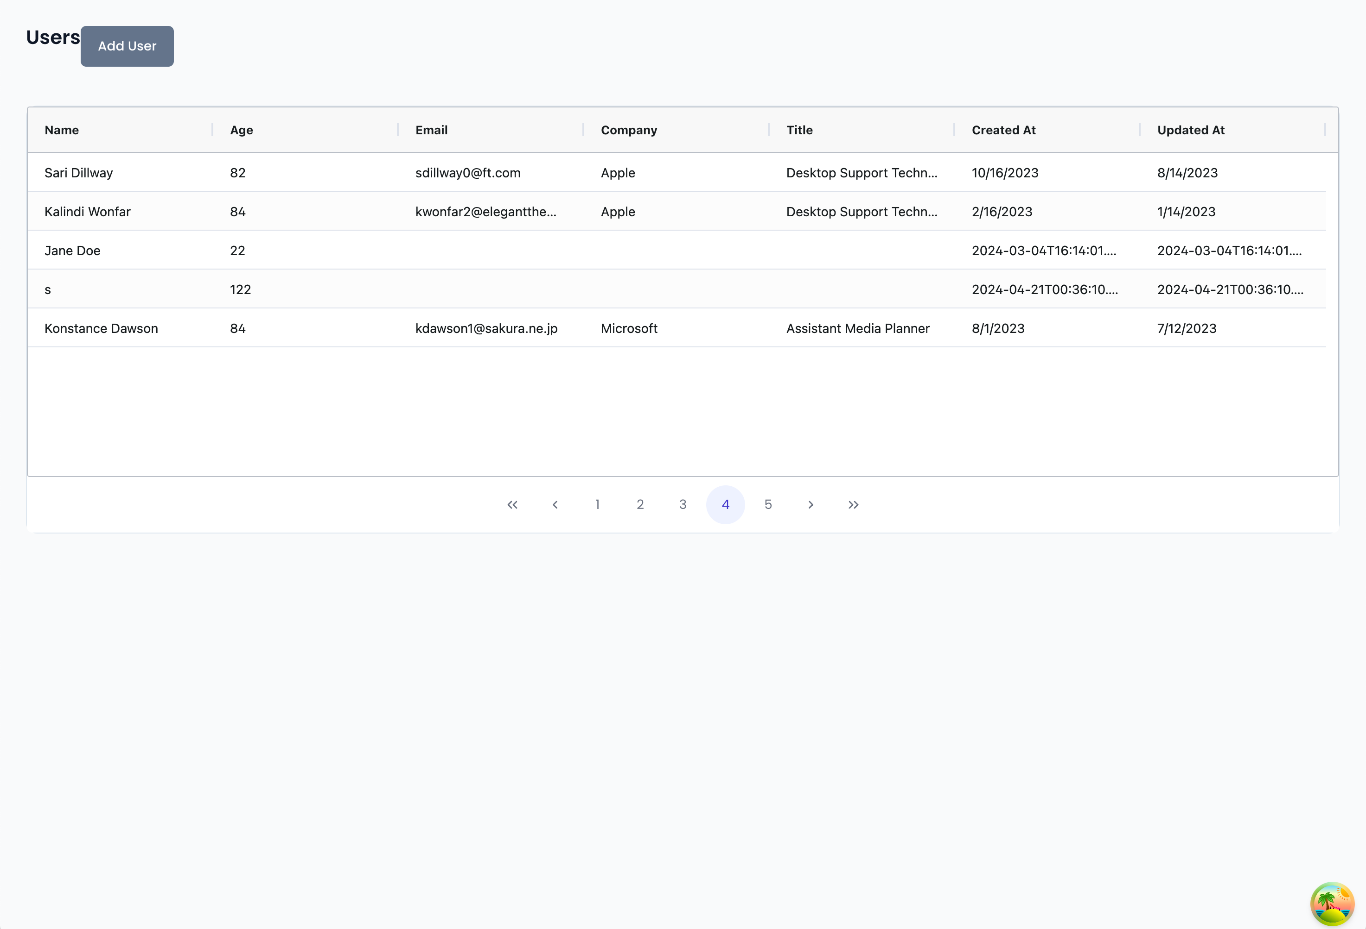

Slide 30
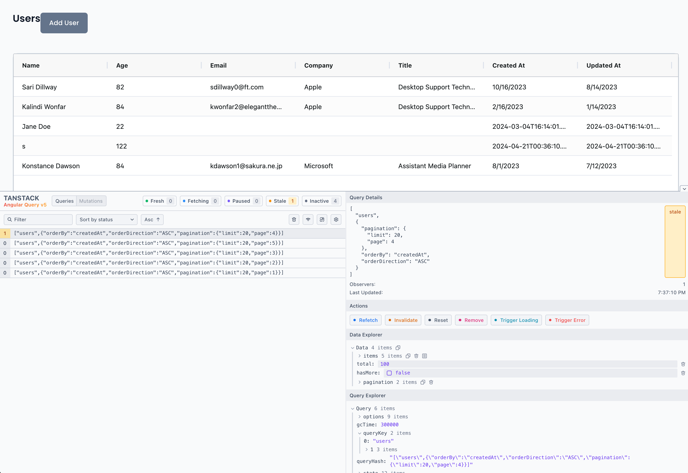

Slide 32
Historial

Slide 33
Filtrar y
ordenar

Slide 34
Estado de las
Queries

Slide 35
Simular Offline

Slide 38
🍿
🍿
🍿

Slide 39
Beneficios
Facil de usar
Tiene Estados
Dev Tools

Slide 40
¿Cómo funciona?

Slide 41
Cache

Slide 42
Cache

Slide 43
Cache
”user”, { page: 1}
[Users]

Slide 44
Cache
”user”, { page: 1}
[Users]

Slide 45
Cache
”user”, { page: 1}
[Users]
”user”, { page: 2}
[Users]

Slide 46
Cache
”user”, { page: 1}
[Users]
”user”, { page: 2}
[Users]

Slide 47
Cache
”user”, { page: 1}
[Users]
”user”, { page: 1}
”user”, { page: 2}
[Users]

Slide 48
Cache
”user”, { page: 1}
[Users]
[Users]
”user”, { page: 1}
”user”, { page: 2}
[Users]

Slide 49
Refetch Automático
Evento de focus
Regresa a Online
Nuevos Observadores

Slide 50
Refetch Automatico
Evento de focus
Regresa a Online
Nuevos Observadores
Actualizaciones del
Query Key

Slide 51
Regresando un poco

Slide 52
export class UsersPageComponent {
#usersApi = inject(UsersApiService);
currentPage = signal(1);
usersRequestOptions = computed(() => {
return {
pagination: {
limit: 20,
page: this.currentPage(),
},
orderBy: 'createdAt’,
} as RequestOptions;
});
usersQuery = injectQuery(() => ({
queryKey: ['users', this.usersRequestOptions()],
}));
onPageChange(e: PaginatorState) {
this.currentPage.update( () => (e.page ? e.page + 1 : 1));
}

Slide 53
export class UsersPageComponent {
#usersApi = inject(UsersApiService);
currentPage = signal(1);
usersRequestOptions = computed(() => {
return {
pagination: {
limit: 20,
page: this.currentPage(),
},
orderBy: 'createdAt’,
} as RequestOptions;
});
usersQuery = injectQuery(() => ({
queryKey: ['users', this.usersRequestOptions()],
}));
onPageChange(e: PaginatorState) {
this.currentPage.update( () => (e.page ? e.page + 1 : 1));
}

Slide 54
export class UsersPageComponent {
#usersApi = inject(UsersApiService);
currentPage = signal(1);
usersRequestOptions = computed(() => {
return {
pagination: {
limit: 20,
page: this.currentPage(),
},
orderBy: 'createdAt’,
} as RequestOptions;
});
usersQuery = injectQuery(() => ({
queryKey: ['users', this.usersRequestOptions()],
}));
onPageChange(e: PaginatorState) {
this.currentPage.update( () => (e.page ? e.page + 1 : 1));
}

Slide 55
Prefetch y Placeholders

Slide 56
API Service
getPage()
getById()
delete()
update()
create()

Slide 57
API Service
Users Queries
getPage()
pageQuery()
getById()
detailsQuery()
delete()
deleteMutation()
update()
updateMutation()
createMutation()
create()

Slide 58
function prefetchNextPageQuery(requestOptions Signal<RequestOptions>) {
const usersApi = inject(UsersApiService);
const queryClient = injectQueryClient();
return {
prefetch: () => {
const currentPage = requestOptions().pagination?.page || 1;
const options = {
...requestOptions(),
pagination: {
...requestOptions().pagination,
page: currentPage + 1,
},
};
return queryClient.prefetchQuery({
queryKey: queryKeys.list(options) ,
queryFn: () => usersApi.fetchPage(options),
});
}};
}

Slide 59
function prefetchNextPageQuery(requestOptions Signal<RequestOptions>) {
const usersApi = inject(UsersApiService);
const queryClient = injectQueryClient();
return {
prefetch: () => {
const currentPage = requestOptions().pagination?.page || 1;
const options = {
...requestOptions(),
pagination: {
...requestOptions().pagination,
page: currentPage + 1,
},
};
return queryClient.prefetchQuery({
queryKey: queryKeys.list(options) ,
queryFn: () => usersApi.fetchPage(options),
});
}};
}

Slide 60
function prefetchNextPageQuery(requestOptions Signal<RequestOptions>) {
const usersApi = inject(UsersApiService);
const queryClient = injectQueryClient();
return {
prefetch: () => {
const currentPage = requestOptions().pagination?.page || 1;
const options = {
...requestOptions(),
pagination: {
...requestOptions().pagination,
page: currentPage + 1,
},
};
return queryClient.prefetchQuery({
queryKey: queryKeys.list(options) ,
queryFn: () => usersApi.fetchPage(options),
});
}};
}

Slide 61
prefetchNextPage = usersQuery.prefetchNextPage(this.#store.requestOptions);
constructor() {
effect(() => {
if (!this.usersQuery.isPlaceholderData()
&& this.usersQuery.data()?.hasMore) {
this.prefetchNextPage.prefetch();
}
});
}

Slide 62
prefetchNextPage = usersQuery.prefetchNextPage(this.#store.requestOptions);
constructor() {
effect(() => {
if (!this.usersQuery.isPlaceholderData()
&& this.usersQuery.data()?.hasMore) {
this.prefetchNextPage.prefetch();
}
});
}

Slide 63
prefetchNextPage = usersQuery.prefetchNextPage(this.#store.requestOptions);
constructor() {
effect(() => {
if (!this.usersQuery.isPlaceholderData()
&& this.usersQuery.data()?.hasMore) {
this.prefetchNextPage.prefetch();
}
});
}

Slide 64
@if (usersQuery.isSuccess()) {
<div [style.opacity]="usersQuery.isPlaceholderData() ? 0.5 : 1">
<ag-grid-angular
[rowData]="users()”
[columnDefs]="columnDefs”
(rowClicked)="onEditUser($event)”
/>
</div>
}

Slide 65
@if (usersQuery.isSuccess()) {
<div [style.opacity]="usersQuery.isPlaceholderData() ? 0.5 : 1">
<ag-grid-angular
[rowData]="users()”
[columnDefs]="columnDefs”
(rowClicked)="onEditUser($event)”
/>
</div>
}

Slide 66
🍿
🍿
🍿

Slide 67
Beneficios
Facil de usar
Tiene Estados
Dev Tools

Slide 68
Beneficios
Facil de usar
Tiene Estados
Dev Tools
Reusable
Prefetch
Placeholders

Slide 69


Slide 70
Para usar NgRx
Usar ngrx entity
Crear boilerplate
Implementar funcionalidades

Slide 71
Estado del Componente
Estado del Servidor

Slide 72
🍿
🍿
🍿

Slide 73


Slide 74
Alfredo
Pérez
@alfrodo_perez
bit.ly/ng-query-peru
bit.ly/cursosland

